Slide 1


Slide 2
Introduction
Il Capo is an online shopping system for Men’s Fashion..
User friendly GUI for customers and for admins.

Slide 3
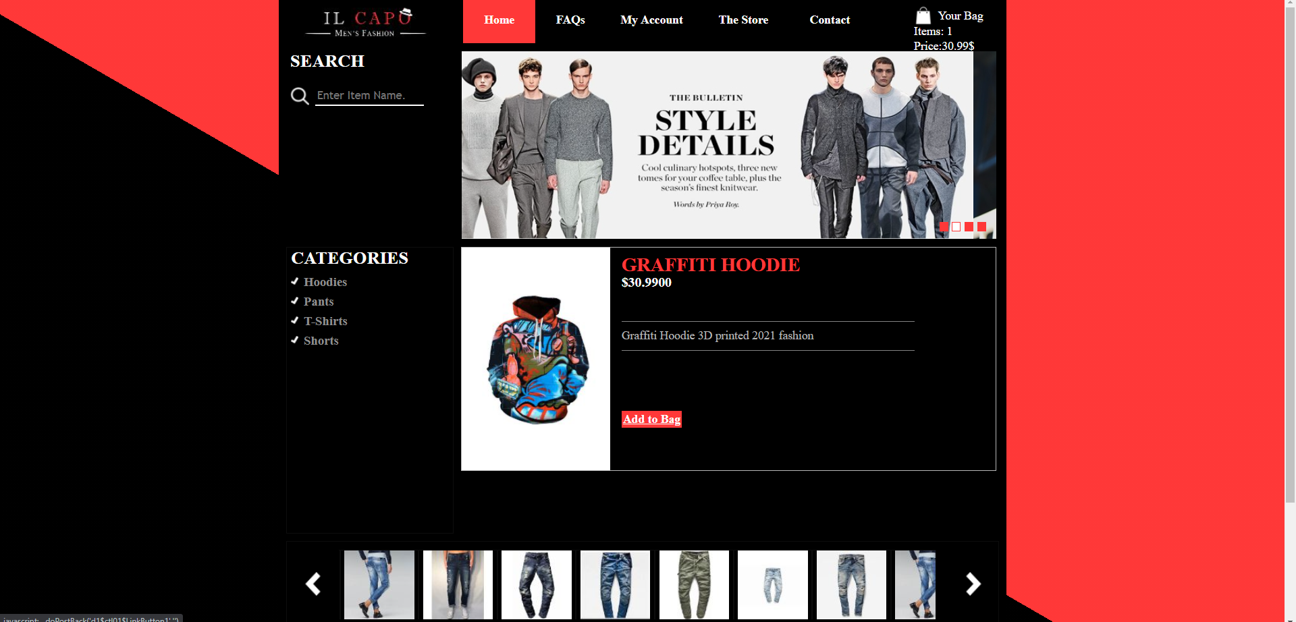
Contents
Technologies
User Mode
Future Work
Show Case

Slide 4
User Mode
Regular User
Sign-Up
Login
Buy Items
Search for products
Browse by category
Display products
View order history
Admin
Add Categories
Manage database
Add products
Delete products
View orders

Slide 5




Technologies
Front End
Back End

Slide 6
Technologies
ASP. Net Webforms Framework

Slide 7
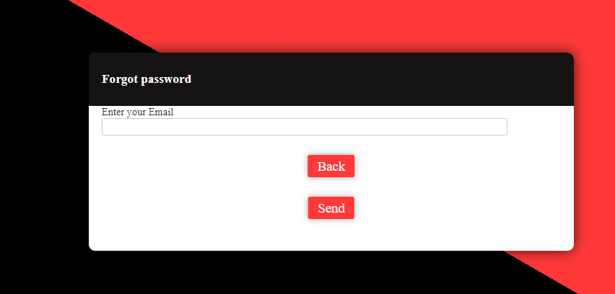
Features
Forgot Password using Simple Mail Transfer Protocol to reset password.
Checks if the email is a
Viable email address if yes,
A link will be sent to the user’s email to reset it.

Slide 8
Future Work
Payment System
Enhancing the design furthermore.
Improved Security
Rating System

